Slide 1
PG4200: Algorithms And Data Structures Lesson 04: Recursion and Test Driven Development (TDD)
Bogdan Marculescu

Slide 2
Recursion

Slide 3
Wikipedia Definition
Recursion in computer science is a method of solving a problem where the solution depends on solutions to smaller instances of the same problem (as opposed to iteration)… Most computer programming languages support recursion by allowing a function to call itself from within its own code.

Slide 4
General Definition
Recursion: see definition of Recursion

Slide 5
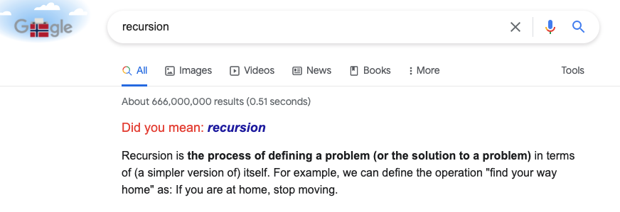

Slide 6
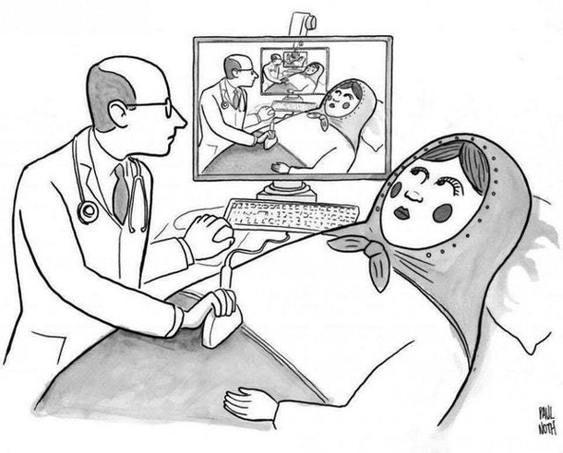
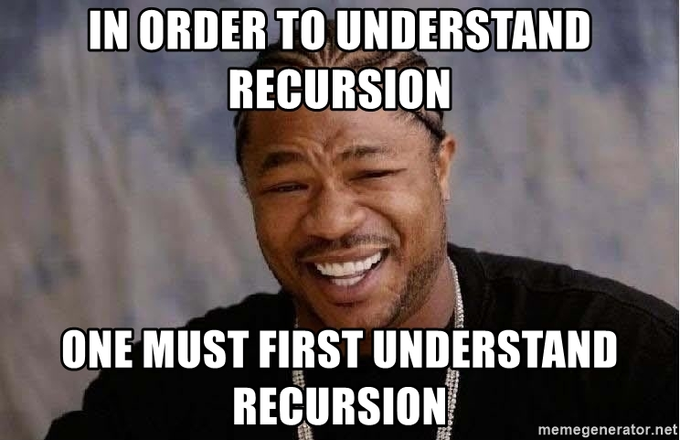
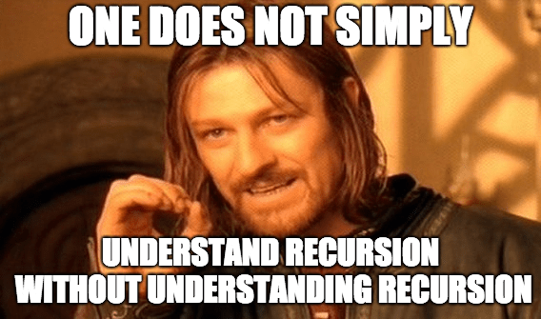
A tricky concept first time you see it… as our brains are wired to think more in an iterative way… but maybe memes help…

Slide 7
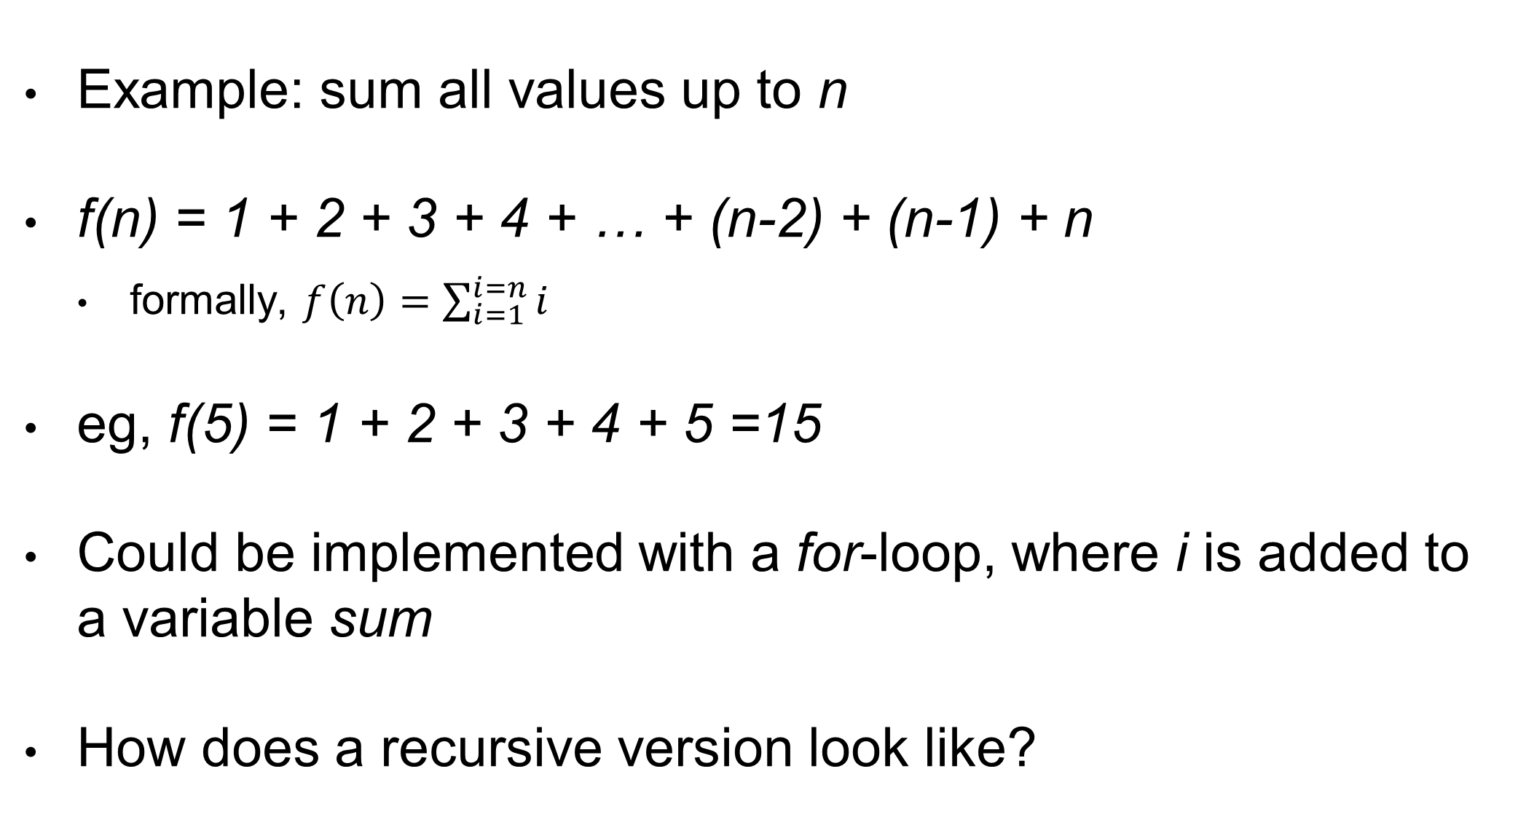
Let’s Try With Math…
Example: sum all values up to n
f(n) = 1 + 2 + 3 + 4 + … + (n-2) + (n-1) + n
formally, $f\left(n\right)=\sum_{i=1}^{i=n}{i}$
eg, f(5) = 1 + 2 + 3 + 4 + 5 =15
Could be implemented with a for-loop, where i is added to a variable sum
How does a recursive version look like?

Slide 8
Recursive Sum
Idea: if we can sum up to n-1, then, to sum up to n, we can just add n
f(n) = n + f(n-1)
eg, f(5) = 5 + f(4)
f(4) = 4 + f(3)
f(3) = 3 + f(2)
f(2) = 2 + f(1)
…

Slide 9
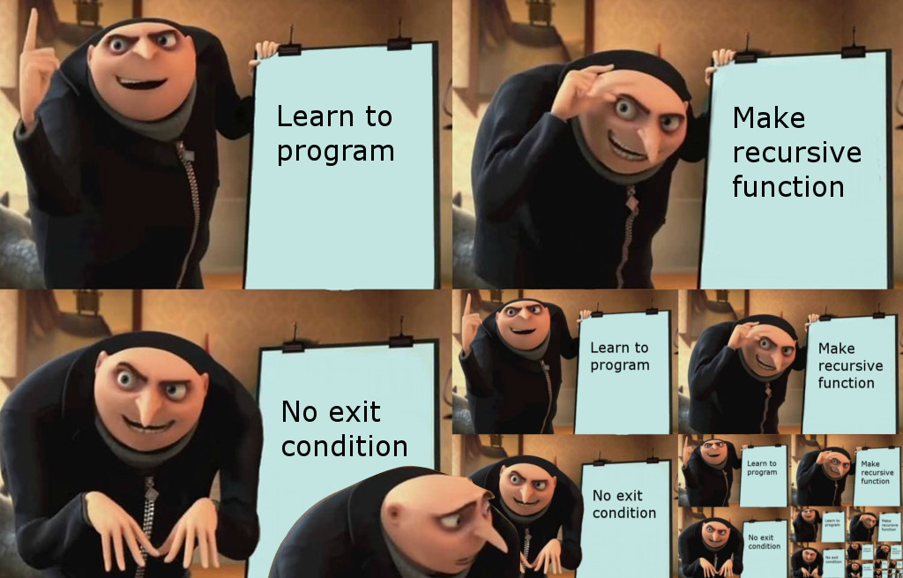
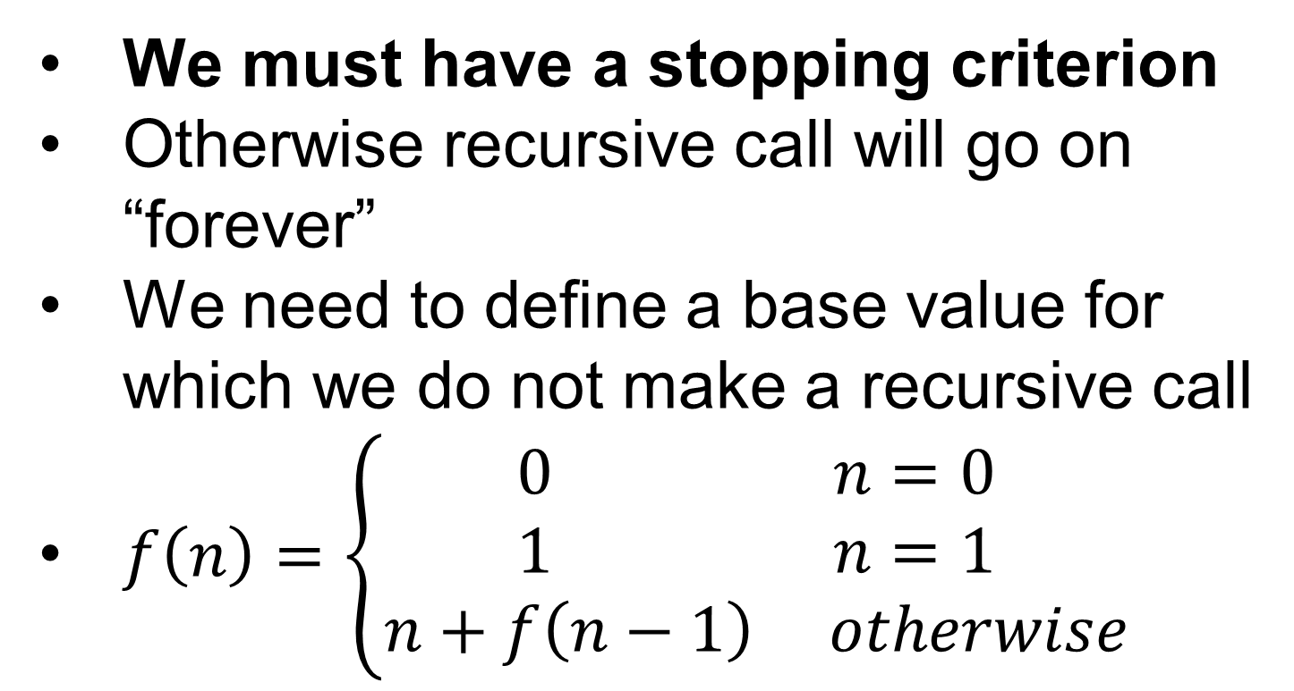
Stopping/Exit Criterion
f(n) = n + f(n-1)
f(5) = 5 + f(4)
f(4) = 4 + f(3)
f(3) = 3 + f(2)
f(2) = 2 + f(1)
f(1) = 1 + f(0)
f(0) = 0 + f(-1)
f(-1) = -1 + f(-2)
f(-2) = -2 + f(-3)
etc.
We must have a stopping criterion
Otherwise recursive call will go on “forever”
We need to define a base value for which we do not make a recursive call
$f\left(n\right)=\left\{\begin{aligned}0 n=0 \\ 1 n=1 \\ n+f\left(n−1\right) otherwise\end{aligned}\right.$

Slide 10
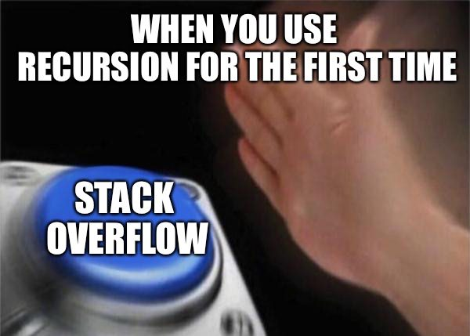
What If No Stopping?
Before f(n) is completed, f(n-1) must be completed
But before f(n-1) is completed, f(n-2) must be completed
And so on…
At each function call, we push a frame on the function call stack
If no stopping criterion, we will push so many frames that we will run out of memory eventually
leading so to a stack overflow exception

Slide 11
Number of Recursive Calls
Considering f(n) = n + f(n-1), how many frames will be pushed?
assume stopping condition for n<=1
We would have O(n) frames
Even if stopping condition, we can get a stack overflow for large enough n
eg, n = 100,000

Slide 12
Reduced Input
In each recursive call, we must reduce the input
How much input is reduced has huge impact on viability of the recursive algorithm
we must avoid stack overflows
If the decrease is linear, then we will have a linear number of frames on stack
which will likely lead to a stack overflow for non-small inputs

Slide 13
Sum Array Example
Let’s sum all values in an array a, from start index s to end index e
where sum(a) = sum(a,0,a.length-1)
Considering 2 different recursive versions
sumX(a,s,e) = a[s] + sumX(a,s+1,e)
sumY(a,s,e) = sumY(a,s,middle) + sumY(a,middle+1,e)
Stopping: s==e -> sum(a,s,e)=a[s]
Both give the right answer, but which version is better?

Slide 14

sumX(a,s,e) = a[s] + sumX(a,s+1,e)
// a = {5,6,7,8}
sumX(a,s,e){
current = a[s]
s==e ? return current
recursion = sumX(a,s+1,e)
return current + recursion
}
0
0
0
0
0
recursion = ?
current = 7
e = 3
s = 2
a = …
recursion = ?
current = 6
e = 3
s = 1
a = …
recursion = ?
current = 5
e = 3
s = 0
a = …
recursion = ?
current = 8
e = 3
s = 3
a = …
recursion = ?
current = 7
e = 3
s = 2
a = …
recursion = ?
current = 6
e = 3
s = 1
a = …
recursion = ?
current = 5
e = 3
s = 0
a = …
0
0
0
0
0
0
0
recursion = ?
current = 5
e = 3
s = 0
a = …
0
0
recursion = ?
current = 6
e = 3
s = 1
a = …
recursion = ?
current = 5
e = 3
s = 0
a = …

Slide 15
Until we reach stopping condition s==e, we keep on making recursive calls, and push new frames on stack
Recall a frame is popped only when its function is terminated
recursion = ?
current = 8
e = 3
s = 3
a = …
recursion = ?
current = 7
e = 3
s = 2
a = …
recursion = ?
current = 6
e = 3
s = 1
a = …
recursion = ?
current = 5
e = 3
s = 0
a = …
recursion = 8
current = 7
e = 3
s = 2
a = …
recursion = ?
current = 6
e = 3
s = 1
a = …
recursion = ?
current = 5
e = 3
s = 0
a = …
recursion =15
current = 6
e = 3
s = 1
a = …
recursion = ?
current = 5
e = 3
s = 0
a = …
recursion= 21
current = 5
e = 3
s = 0
a = …

Slide 16
sumY(a,s,e) = sumY(a,s,middle) + sumY(a,middle+1,e)
// a = {5,6,7,8}
sumY(a,s,e){
s==e ? return a[s]
middle = (s+e)/2
left = sumY(a,s,middle)
right = sumY(a,middle+1,e)
return left + right
}
0
0
0
0
0
0
left = ?
right = ?
middle = 0
e = 1
s = 0
a = …
left = ?
right = ?
middle = 1
e = 3
s = 0
a = …
left =?
right = ?
middle = ?
e = 0
s = 0
a = …
left = ?
right = ?
middle = 0
e = 1
s = 0
a = …
left = ?
right = ?
middle = 1
e = 3
s = 0
a = …
0
0
0
0
0
0
left = ?
right = ?
middle = 1
e = 3
s = 0
a = …

Slide 17
Before we compute the right half, we wholly compute the left half, including all its internal recursive calls (left and right)
left =?
right = ?
middle = ?
e = 0
s = 0
a = …
left = ?
right = ?
middle = 0
e = 1
s = 0
a = …
left = ?
right = ?
middle = 1
e = 3
s = 0
a = …
left = 5
right = ?
middle = 0
e = 1
s = 0
a = …
left = ?
right = ?
middle = 1
e = 3
s = 0
a = …
end = ?
right = ?
middle =?
e = 1
s = 1
a = …
left = 5
right = ?
middle = 0
e = 1
s = 0
a = …
left = ?
right = ?
middle = 1
e = 3
s = 0
a = …
left = 5
right = 6
middle = 0
e = 1
s = 0
a = …
left = ?
right = ?
middle = 1
e = 3
s = 0
a = …
left = 11
right = ?
middle = 1
e = 3
s = 0
a = …

Slide 18
Once we compute left=11, we enter in the call right=sumY(middle+1,e)
left = 11
right = ?
middle = 1
e = 3
s = 0
a = …
left = ?
right = ?
middle = 2
e = 3
s = 2
a = …
left = 11
right = ?
middle = 1
e = 3
s = 0
a = …
end = ?
right = ?
middle =?
e = 2
s = 2
a = …
left = ?
right = ?
middle = 2
e = 3
s = 2
a = …
left = 11
right = ?
middle = 1
e = 3
s = 0
a = …
left = 7
right = ?
middle = 2
e = 3
s = 2
a = …
left = 11
right = ?
middle = 1
e = 3
s = 0
a = …
left = ?
right =?
middle = ?
e = 3
s = 3
a = …
left = 7
right = ?
middle = 2
e = 3
s = 2
a = …
left = 11
right = ?
middle = 1
e = 3
s = 0
a = …

Slide 19
Once both left and right are recursively computed, the final returned result is 11+15 = 26
left = ?
right =?
middle = ?
e = 3
s = 3
a = …
left = 7
right = ?
middle = 2
e = 3
s = 2
a = …
left = 11
right = ?
middle = 1
e = 3
s = 0
a = …
left = 7
right = 8
middle = 2
e = 3
s = 2
a = …
left = 11
right = ?
middle = 1
e = 3
s = 0
a = …
left = 11
right = 15
middle = 1
e = 3
s = 0
a = …
26

Slide 20
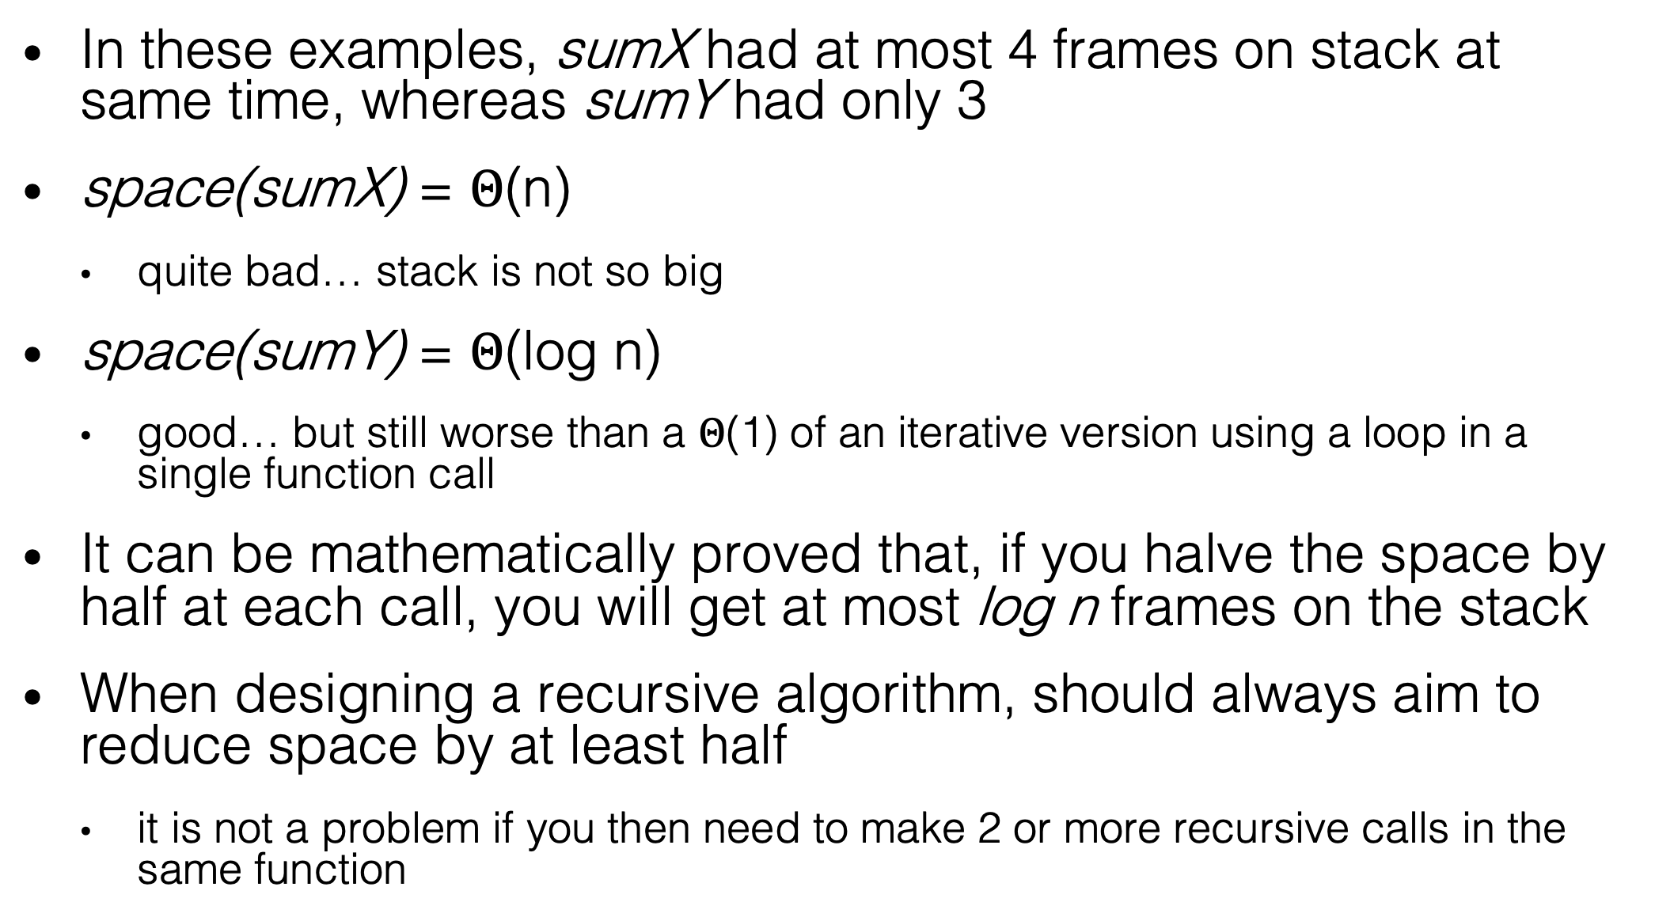
Space Complexity
In these examples, sumX had at most 4 frames on stack at same time, whereas sumY had only 3
space(sumX) = $Θ$(n)
quite bad… stack is not so big
space(sumY) = $Θ$(log n)
good… but still worse than a $Θ$(1) of an iterative version using a loop in a single function call
It can be mathematically proved that, if you halve the space by half at each call, you will get at most log n frames on the stack
When designing a recursive algorithm, should always aim to reduce space by at least half
it is not a problem if you then need to make 2 or more recursive calls in the same function

Slide 21
Important to Remember
3 main aspects in recursive functions
Stopping Criterion: otherwise no end, until a stack overflow
Reduced Input: aim at least at halving it
Combine Results: once recursive calls finished, combine their outputs together for the final result
often it is not as trivial as doing a +

Slide 22
Why Use Recursion???

Slide 23
Recursion vs. Iterative
Iterative versions of algorithms are “usually” better
recall that each recursive call has to create and push a new function call frame
However, there are many algorithms that are easier and more efficient to write in a recursive form
this will become more evident when we will start to work with Trees
Recursive sorting: Merge Sort and Quick Sort

Slide 24
Merge Sort
Divide and Conquer
Recursive implementation
Split the array in two
Sort the two parts
Merge the two parts once sorted
4 | 5 | 1 | 3 | 2 | 6
4 | 5 | 1 | 3 | 2 | 6
1 | 4 | 5 | 2 | 3 | 6
1 | 2 | 3 | 4 | 5 | 6

Slide 25
Recursion
Writing mergeSort(T[] array)
How to sort the 2 halves if my goal was to write a sort algorithm???
Recursion: reuse function you are writing, but on smaller data
mergeSort(T[] array){
mergeSort(array, 0, array.length / 2)
mergeSort(array, array.length /2 , array.length)
mergeHalves(array)
}

Slide 26
Recursion End
To avoid infinite loop, you need to define a stopping condition
When do I know for certain that an array is sorted?
Answer: when its size is at most 1
So, stop recursion when reaching an half of size 1 or less

Slide 27
Merge of Halves
By recursion, I can sort the 2 halves, but array with 2 sorted halves is not sorted
Scan the 2 halves, and copy min to a new array
Between N/2 and N comparisons: once reached end of one half, copy over the other
1 | 4 | 5
1 | 4 | 5
2 | 3 | 6
2 | 3 | 6
1
1 | 2
1 | 4 | 5
1 | 4 | 5
2 | 3 | 6
2 | 3 | 6
1 | 2 | 3
1 | 2 | 3 | 4

Slide 28
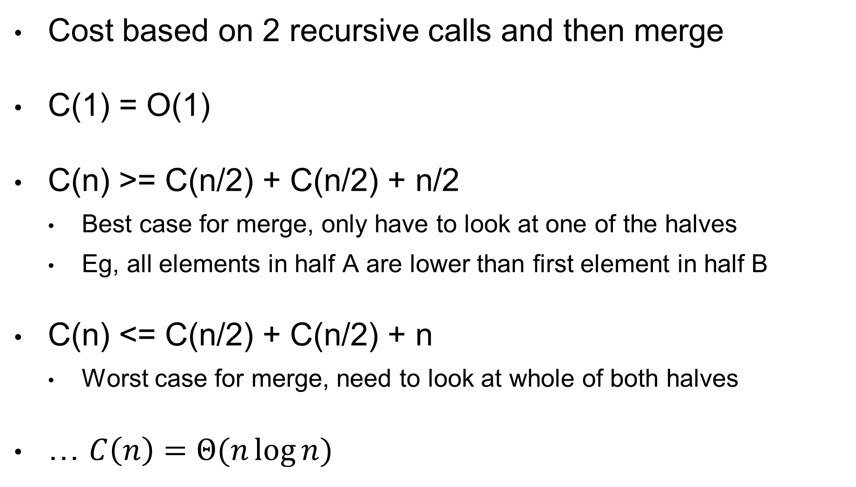
Cost
Cost based on 2 recursive calls and then merge
C(1) = O(1)
C(n) >= C(n/2) + C(n/2) + n/2
Best case for merge, only have to look at one of the halves
Eg, all elements in half A are lower than first element in half B
C(n) <= C(n/2) + C(n/2) + n
Worst case for merge, need to look at whole of both halves
… $C\left(n\right)=Θ(n\log{n})$

Slide 29
Considerations
Asymptotically, does not exist comparison-based sorting better than O(n log n)
Merge-sort is therefore asymptotically optimal
Ie, no instance for which get worse than O(n log n)
But… more memory, need extra array buffer
… might be not best on average

Slide 30
Wikipedia
Besides book, Wikipedia is good source to read about algorithms and data structures in layman terms
https://en.wikipedia.org/wiki/Merge_sort

Slide 31
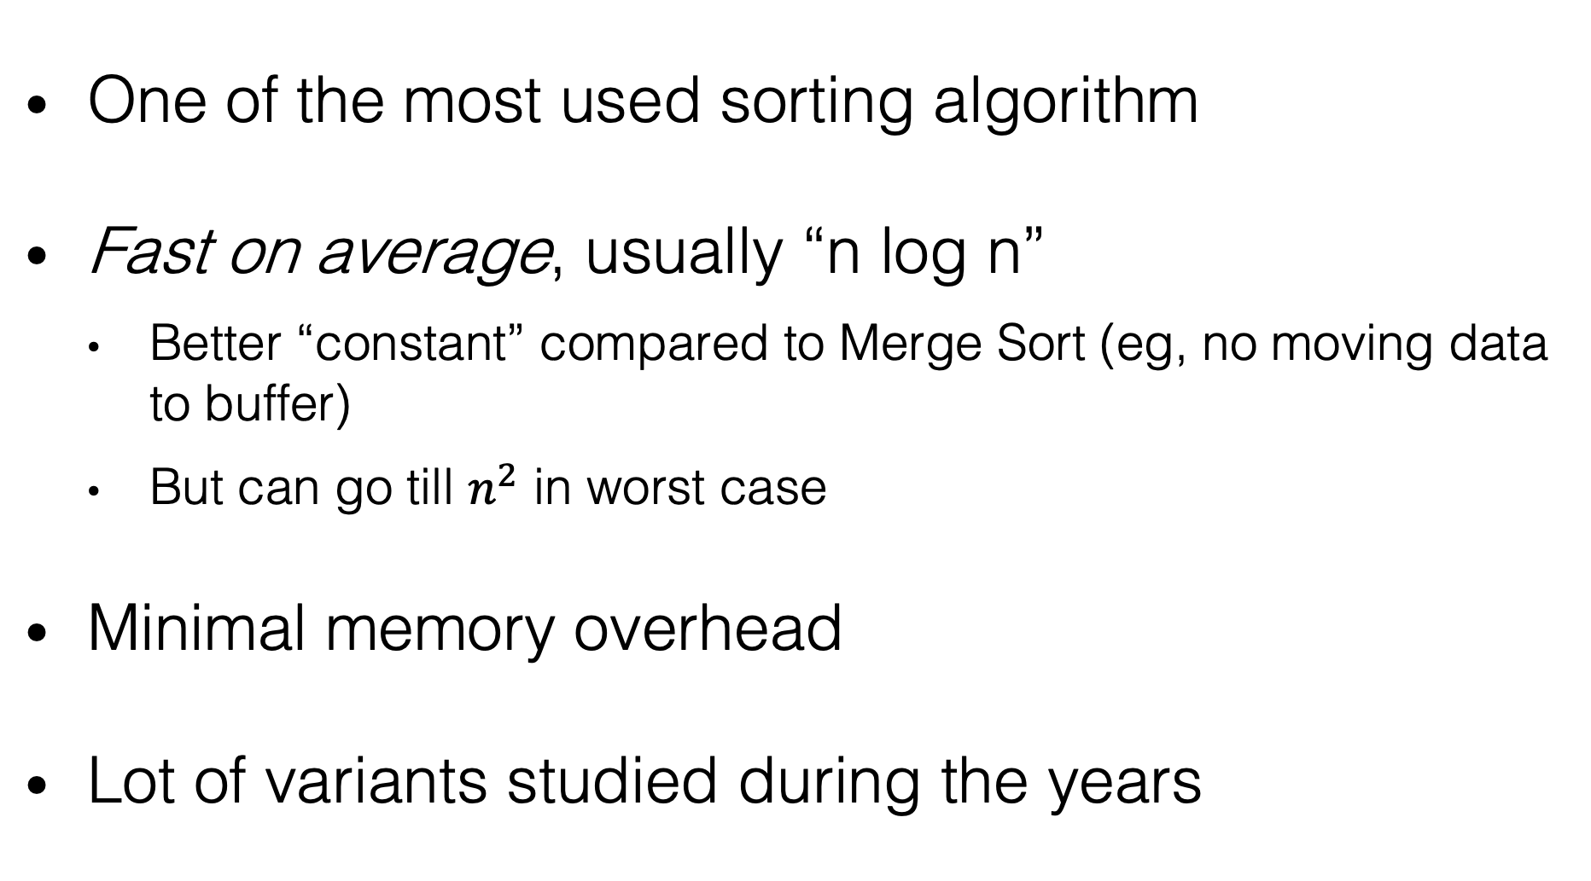
Quick Sort
One of the most used sorting algorithm
Fast on average, usually “n log n”
Better “constant” compared to Merge Sort (eg, no moving data to buffer)
But can go till $n^{2}$ in worst case
Minimal memory overhead
Lot of variants studied during the years

Slide 32
Recursion
Still Divide and Conquer algorithm, like Merge Sort
Choose a value X (pivot)
Move values <X before X, and >X after it
After one step X is in the correct position
Apply recursion on subarrays before and after X

Slide 33
Choose a pivot, eg value 5
Scan from left till > 5, from right till < 5
Swap (eg 6 with 1), and continue
Note how 3 is not touched, as < 5
At the end, the pivot 5 is in the right position
On left side, all values < 5
On right side, all values > 5
Apply recursively on left and right of pivot
6 | 3 | 7 | 5 | 4 | 2 | 1
1 | 3 | 7 | 5 | 4 | 2 | 6
1 | 3 | 7 | 5 | 4 | 2 | 6
1 | 3 | 2 | 5 | 4 | 7 | 6
1 | 3 | 2 | 5 | 4 | 7 | 6
1 | 3 | 2 | 4 | 5 | 7 | 6
1 | 3 | 2 | 4 | 5 | 7 | 6

Slide 34
Choice of Pivot
Choice of pivot is crucial for performance of Quick Sort
pivot = array[i]
For performance, would like a pivot value that gives the 2 partitions of equal size
How to choose “i”?
An option is to take “i” at random
Another option is to take middle, which is good when array nearly sorted
1 (and 7) is worst choice
4 | 3 | 7 | 1 | 5 | 2 | 6
4 is best choice
4 | 3 | 7 | 1 | 5 | 2 | 6

Slide 35
Which Sorting Algorithm to Use?
Unless you have very specific, advanced cases, you use the default of what is given by the standard library of the language/framework you use
Most of the time, it will be a variant of Quick or Merge Sort
eg in Java (and Python) the default is TimSort, which is an hybrid algorithm based on Merge and Insertion Sort.
you can look at code directly at java.util.TimSort

Slide 36
Test Driven Development (TDD)

Slide 37
TDD in One Slide
First write the test cases, which will fail, and then write code to make the test cases pass

Slide 38
What TDD is Not
It is not a fancy tool you can buy/download
No cutting edge novel technology
No silver bullet solving all your software development problems
It is just a (relatively simple) design methodology to improve productivity

Slide 39
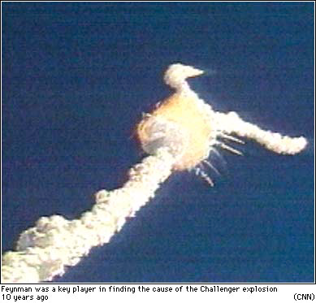
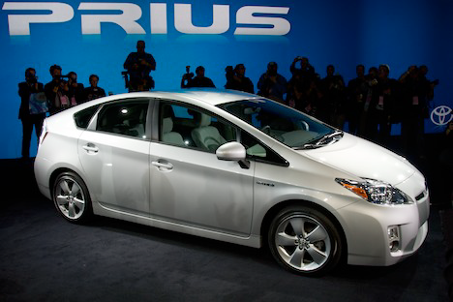
Why TDD???
Bugs in the field can be extremely expensive
Ariane 5 explosion, Toyota braking system (100k recalled cars), etc
Aim at improving quality (“testing”) within acceptable cost
Lot of hype on TDD as possible solution

Slide 41
Some Facts on TDD
There isn’t much scientific evidence that it helps on large scale systems
Small improvements in quality, but also small decrease in productivity
But many anecdotal, success stories
My opinion might be different from what you might hear/read on TDD

Slide 42
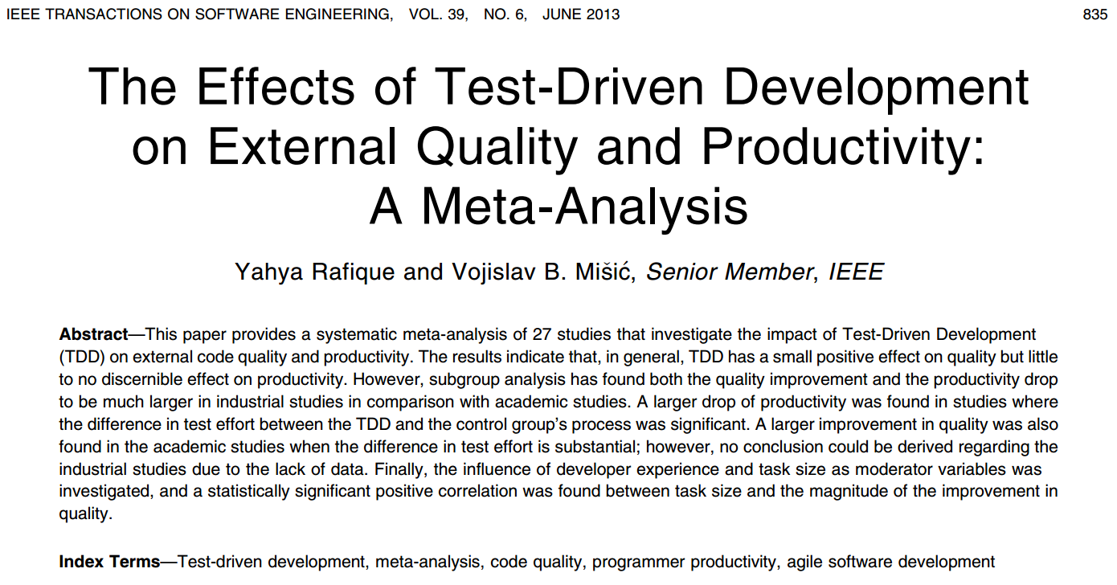

Slide 43
TDD and Algorithms
Algorithms is a good a place to start with TDD, as having clear functions with clear expected outputs
Lot of hype on TDD
However, here we deal with small functions and classes, and not whole applications

Slide 44
Do You Practice What You Preach?
TDD can be useful, especially for students / junior developers
But to be honest, I am not using TDD...
TDD is a bottom-up approach to software design
As any technique, its success depends on the context
eg, type of software, stage in which TDD is introduced (at the beginning or in a mature project), etc
Can test software even without TDD
Success of TDD depends also on management

Slide 45
General Principles of TDD

Slide 46
- Empty code stub
- Test case that fails
- Integrate changes (eg commit to Git)
- Minimal coding to pass test case
- Refactor to improve code

Slide 47
Example: A List
//Start from an “empty” stub that compiles
class List{
int size(){return -1; //wrong value}
}

Slide 48
First Unit Test
void testEmptyList(){
List list = new List();
Assert.equals( 0 , list.size());
// expected empty list
}
This will fail!

Slide 49
Fix The Code
class List{
int size(){return 0;}
}
Now the test case does not fail

Slide 50
Refactor Step
class List{
int counter = 0;
int size(){return counter;}
}
Improve code

Slide 51
Integration Step
As all test cases do pass, make changes permanent
Example: commit to repository
Git, CVS, SVN, Mercurial, etc.
Do you really need to committ at each TDD step??? I do not think so...
overhead, tedious, side effects if email generated for each commit, etc.

Slide 52
Back to First Step
class List{
int counter = 0;
void insert(int value){ /* do nothing */}
int size(){return counter; }
}

Slide 53
Write A Second Test
void testInsertOneElement(){
List list = new List();
list.insert(42);
Assert.equals( 1 , list.size());
}
This will fail!

Slide 54
Minimal Fix
Does not work:
- testInsertOneElement does pass
- but testEmptyList will fail
class List{
int counter = 1;
void insert(int value){ }
int size(){return counter; }
}

Slide 55
Still need all passing tests
class List{
int counter = 0;
void insert(int value){ counter++;}
int size(){return counter; }
}

Slide 56

Refactoring Step
class List{
int[] data = new int[16];
int counter = 0;
void insert(int value){ data[counter]=value;
counter++;}
int size(){return counter; }
}
Do not do that!
You have no test case checking for internal state!

Slide 57
New Empty Stub
class List{
int counter = 0;
void insert(int value){ counter++;}
int size(){return counter; }
int getLast(){return 0;}
}

Slide 58
Write A Third Test
void testInsertAndGetOneElement(){
List list = new List();
int value = 42;
list.insert(value);
Assert.equals( value , list.getLast());
}
Note: we are not testing for “size” here
This will fail!

Slide 59
Minimal Fix Before Refactoring
class List{
int counter = 0;
void insert(int value){ counter++;}
int size(){return counter; }
int getLast(){return 42;}
}

Slide 60
And so on... keep following the cycle
Test
Integrate
Code
Refactor

Slide 61
Measuring Test Effectiveness
Big issue, regardless of TDD
#bugs found in QA is a tricky measure
Code coverage is often used

Slide 62

TDD
Set Of Test Cases
54% Statement Coverage
“Regular” Development
Set Of Test Cases
54% Statement Coverage

Slide 63
TDD and Coverage
TDD is not about more code coverage
Managers can just set a target (eg >50%) and let engineers decide how to achieve it
TDD is about design

Slide 64
Coverage Does Not Tell You Much
void testInsertOneElement(){
List list = new List();
list.insert(42);
int size = list.size();
Assert.equals( 1 , size );
}
Let’s say 15% coverage
Coverage does not change!!!
//

Slide 65
How Good Are Your Test Assertions?
Current tools cannot tell you that
However, “Mutation Testing” is starting to get usable
TDD helps you because force you to write effective assertions
tests first need to fail, and then pass

Slide 66
TDD is A Design Methodology
You can write tests even without TDD
Incremental, small steps, each one verified
Can be useful for complex code
Can apply TDD only on subset of a project
TDD might lead to write very different code
impact on architecture

Slide 67
Homework
Study Book Chapter 2.2 and 2.3
Study code in the org.pg4200.les04 package
Do exercises in exercises/ex04
Extra: do exercises in the book

